Slide 1
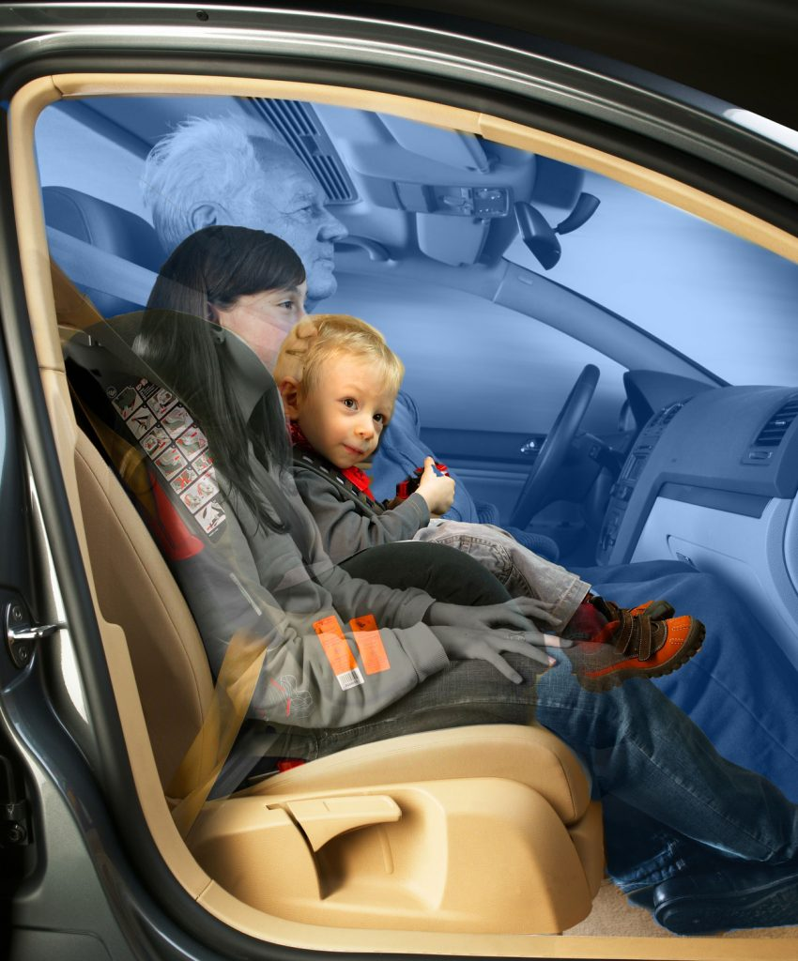
OCCUPANT AND CLASSIFICATION
Presented by,
1. VISHAL
2. ROSHAN
3. ANKIT
4. KAVYA SRI
5. AKSHATA

Slide 2
Contents
INTRODUCTION
CUSTOMER REQUIREMENT
SYSTEM BLOCK DIAGRAM
HARDWARE BLOCK DIAGRAM
FUNCTIONAL BLOCK DIAGRAM
SEQUENTIAL BLOCK DIAGRAM
TEST CASE
TEST RESULTS

Slide 3
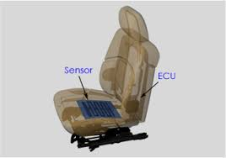
INTRODUCTION
Occupant classification system (OCS) is a system in which the front passenger seat is equipped with occupant detection and classification sensors that prevent the front passenger airbag from deploying if the system detects a non-living object occupying the seat.
OCS is important part for making sure the air bag properly protects the passenger
This system includes CAN input , Hardware input and hardware output
This will enable you to check for proper operation to ensure a complete, safe and quality repair

Slide 4
CUSTOMER REQUIREMENT

Slide 5

SYSTEM BLOCK DIAGRAM
Seat Belt Status
Faulty status if input CAN message is missing
CAN I/P
Occupant Classification
(Processed data stored in Memory)
SW3 AND SW4 Combination
HW I/P
Occupant Status
CAN O/P
Passenger Airbag Disable/Enable

Slide 6
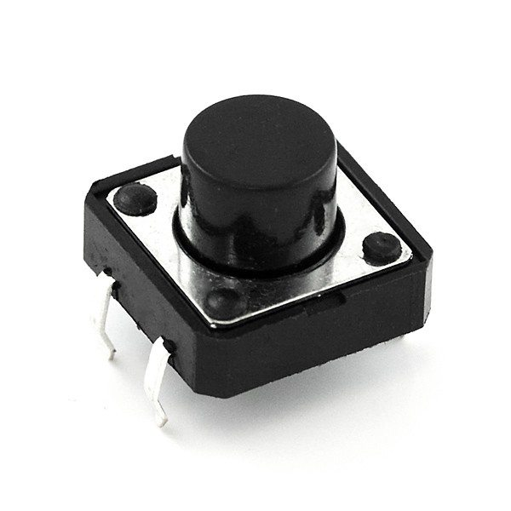


HARDWARE BLOCK DIAGRAM
Transceiver
RX TX GND VCC
RB3
RB2
GND
VCC
MICROCONTROLLER 2551
RB0
RB5
Mechanical
s/w 1
LED 1
EEPROM
RB1
RB6
Mechanical
s/w 2
LED 2
5V Power Supply

Slide 7
FUNCTIONAL BLOCK DIAGRAM
.
SET BAUDRATE
Setting CANCON=Config,
Baudrate=250,
BRGCON1,BRGCON2,BRGCON3
CANCON=Normal
2. CAN_INIT();
Configure
CANCON1 to config mode,
Set CANCON
1. SYS_INIT();
GIE
PEIE
DELAY
4. EEPROM WRITE();
Write the received value
6. EEPROM READ
READ(Address,state,value)
Read the value and stores the Address
VOID MAIN();
SYS_INIT()
CAN_INIT()
SET BAUDRATE
EEPROM READ()
EEPROM WRITE()
CAN_TX()
CAN_RX()
OCCUPANT CLASSIFICATION
AIRBAG_STATUS
SWITCH()
SEAT BELT STATUS
WARNING LAMP
8. OCCUPANT CLASSIFICATION
00 Child Lamp ON
01 Adult 95% Lamp Off
10 Small Adult: Lamp Blink Every 5 Sec
11 Empty Lamp Blink Every 10 sec
5.SWITCH();
SW1,SW2
7. CAN_TX();
Transmits the state value that is stored in EEPROM
3. CAN_RX();
Receive the input from can Transmitter
9. AIRBAG_STATUS
Child : off
Adult : on
Small Adult : off
No Occupants : off

Slide 8
SEQUENTIAL FLOW CHART
Start
Main()
Sys init ()
Can init ()
Seat Belt Status
Receive
Occupant Classification
EEPROM Write
00
Switch
01
10
Transmit
EEPROM Read
11
Air Bag Status
Exit

Slide 9
SYSTEM AND CAN INITIALIZATION
SYSTEM INIT()
CAN INIT()
Setting up
Enabling
Enable transceiver=1
CANCON1 to config mode
GIE=1;
PEIE=1;
While ()
CANSTAT!=00
False
True
SET BAUDRATE
Setting CANCON=Config,
Baud rate =250,
BRGCON1,BRGCON2,BRGCON3
CANCON=Normal
Exit

Slide 10
RECEIVE
Start
RxBMCON=0x20
SIDH
SIDL
DLC=0x08
msg[0]=RxBnD0
To
Msg[7]=RxBnD7
Mask()
Filter()
Mask Enabling to
Filter
Msg[0]=RxFmSIDH
to
Msg[1]=RxFmSIDL
Exit

Slide 11
SEAT BELT STATUS
START
Receive()
If(seat_belt is =1)
NO
YES
LED1=ON
LED1=OFF
Exit

Slide 12
SWITCH
Start
Enable
INTOIE=1
Interrupt Flag()
If(Flag==1)
Return;

Slide 13
EEPROM WRITE
START
Switch()
EEADR=0x04
EEDATA=0x11
Enable
EECON2=55;
EECON2=AA
Main()

Slide 14
EEPROM READ
Start
Occupant
Classification
EEADR=0x04
EEDATA=0x11
Return
Main()

Slide 15
Occupant Classification
Start
if(button==00)
False
True
else if(switch==01)
LED=ON
False
True
else if(switch==10)
LED=OFF
false
True
LED=blinking for every 5 sec
LED=blinking for every 10 sec
Exit

Slide 16
AIRBAG
Start
Transmit()
If(switch==01)
NO
Yes
Air_bag is Deployed
Air_bag is not Deployed
Exit

Slide 17
TRANSMIT
Start
Occupant classification()
Enable CANCON=00
Enable TXBMCON to 0x77/0x73
Enable TXBMSIDH &
TxBMSIDL
Give the Actual DATA
Enable TXBMDLC to 8 bits
Give a Tx Request
main
Exit

Slide 18
TEST CASES
TEST CASE | TEST CASE STEPS | TEST CASE RESULT
PRE CONDITIONS | ECU is powered ON | led should be ON
 | ECU is powered OFF | led should be OFF
CONNECTION ECU TO CAN BUS | message is received | led should be OFF
 | message is not received | led should be ON
CONNECTION LED AND SWITCHES | Turning SW 1 & SW 2 OFF | LED should be ON(child)
 | Turning SW 1 OFF & SW 2 ON | LED should be OFF(Adult)
 | Turning SW 1 ON& SW 2 OFF | LED should be blink in evry 5 seconds(small adult)
 | Turning SW 1 ON& SW 2 ON | LED should be blink in evry 10 seconds(empty)
TRANSMITTING SEAT BELT STATUS & OCCUPANT STATUS TO ECU FOR AIR-BAG DEPLOYMENT | Checking seat belt status message is received & person occupied is child | AIR-BAG status should not be deployed
 | Checking seat belt status message is not received & person occupied is adult | AIR-BAG status should be deployed
 | Checking seat belt status message is received & person not occupied is small adult | AIR-BAG should not be deployed
 | Checking seat belt status message is not received & person not occupied | AIR-BAG should not be deployed
 | storing data(write) in EEPROM | read the data written in EEPROM

